Slide 1

UNIT II
DRUGS ACTING ON AUTONOMIC NERVOUS SYSTEM
ADRENERGIC NEUROTRANSMITTERS

Slide 2
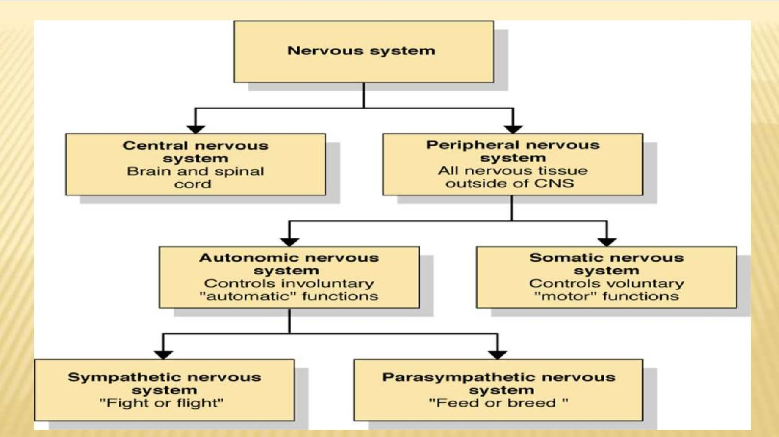

Slide 3
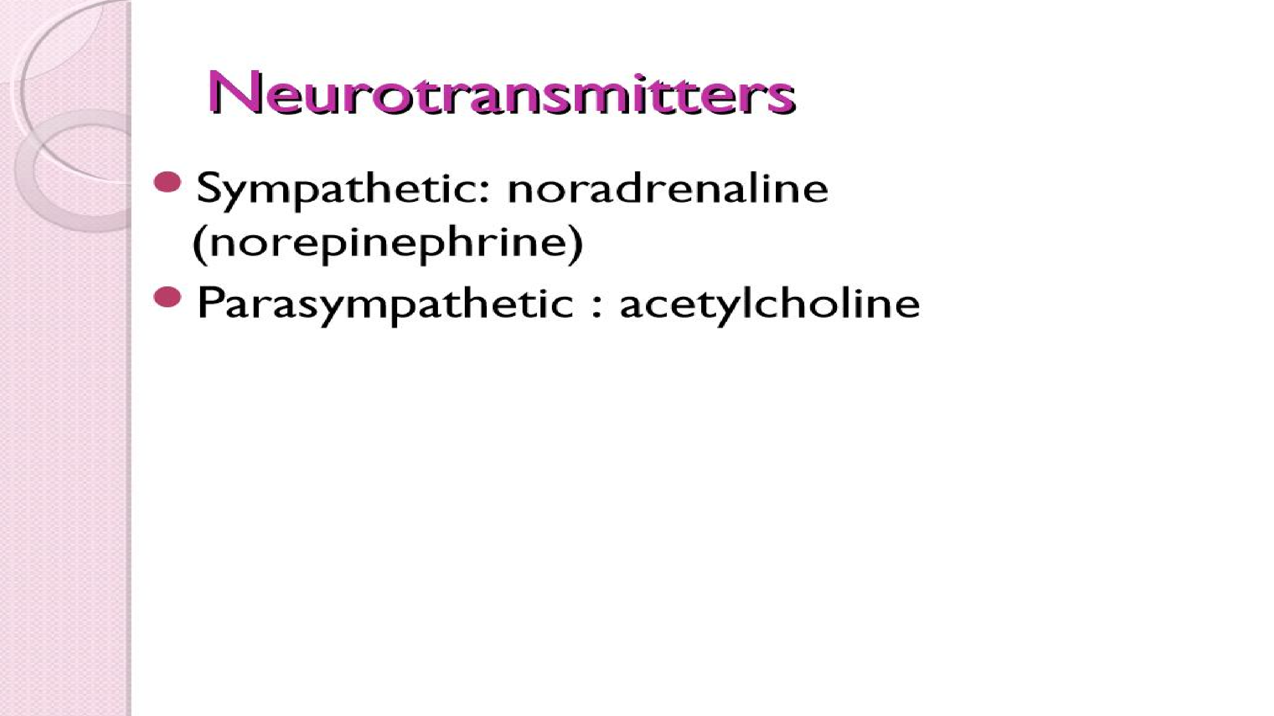

Slide 4
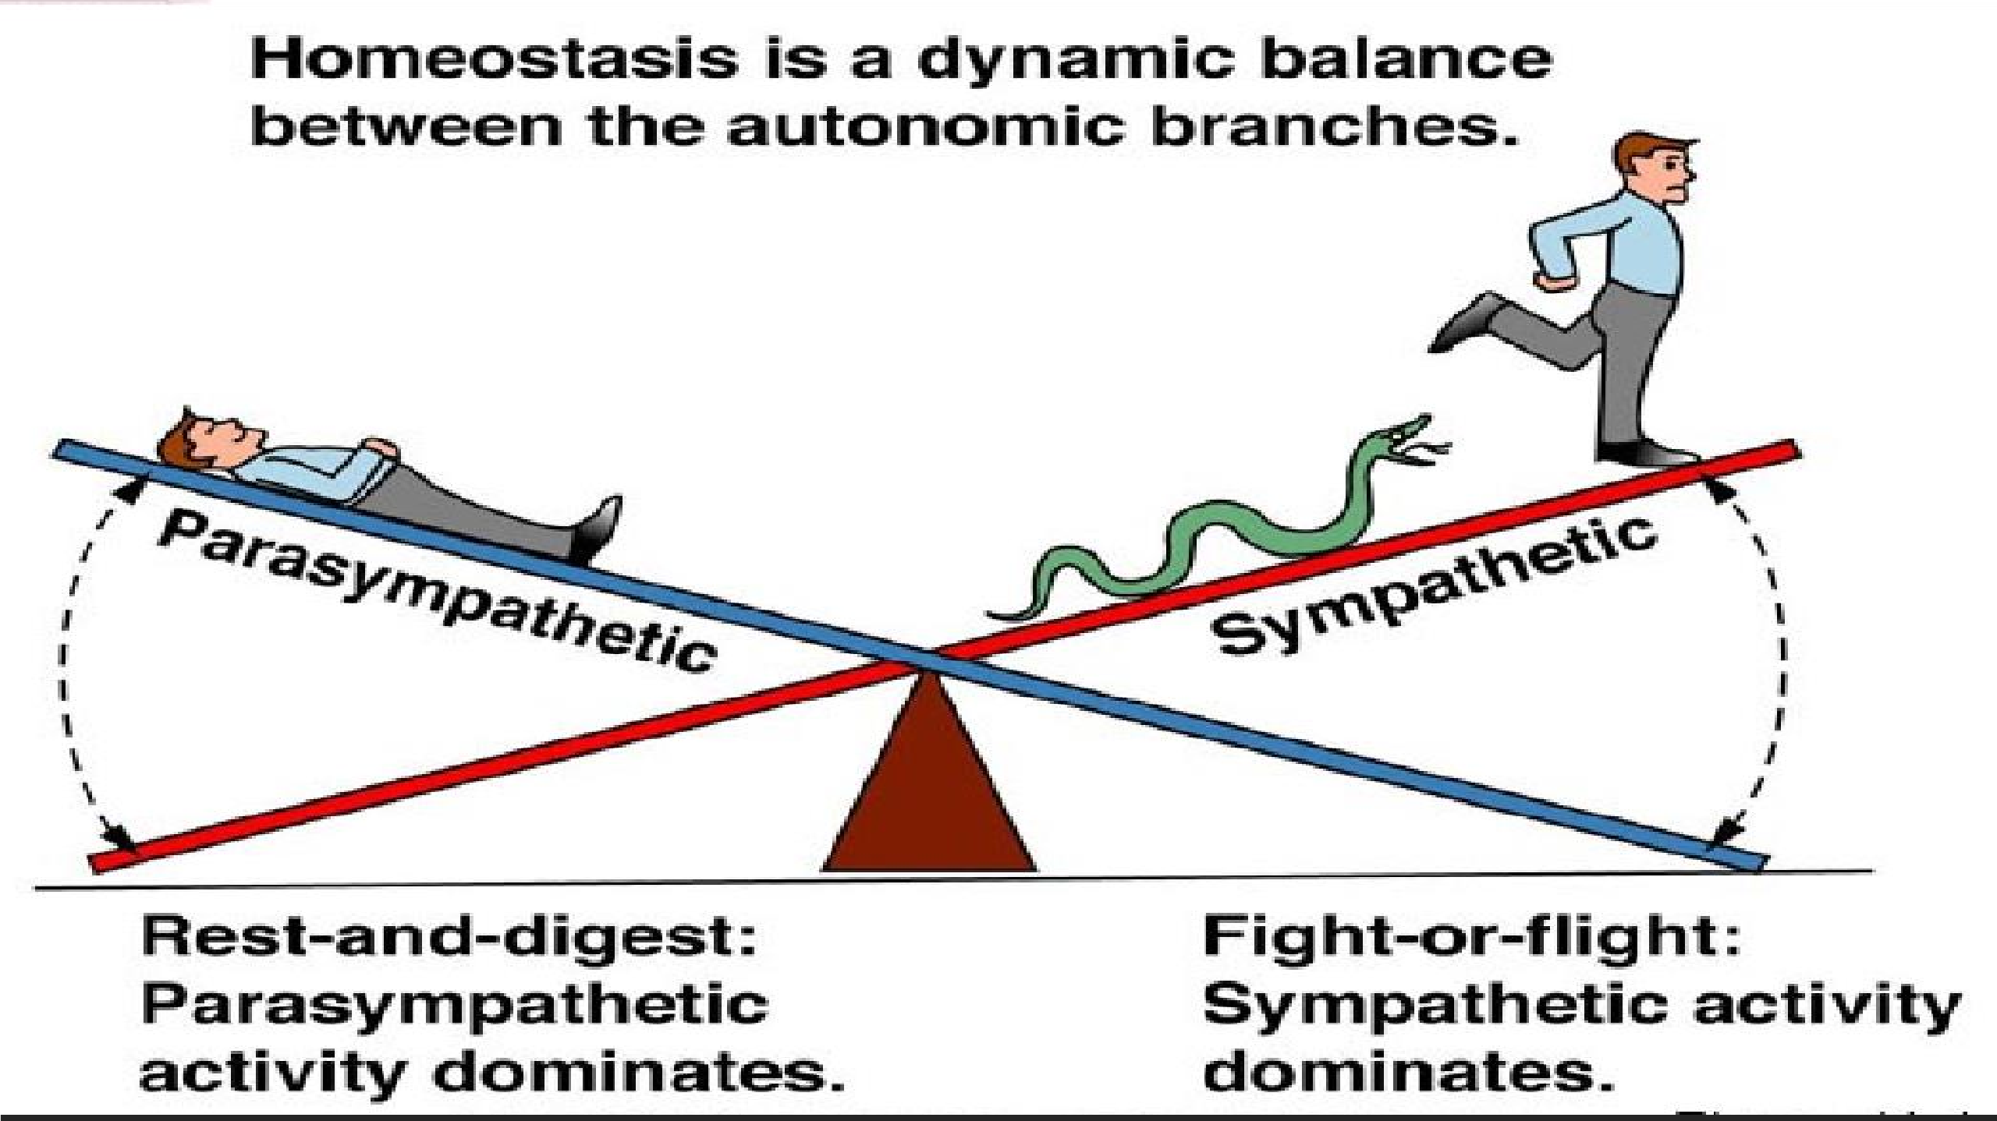

Slide 5
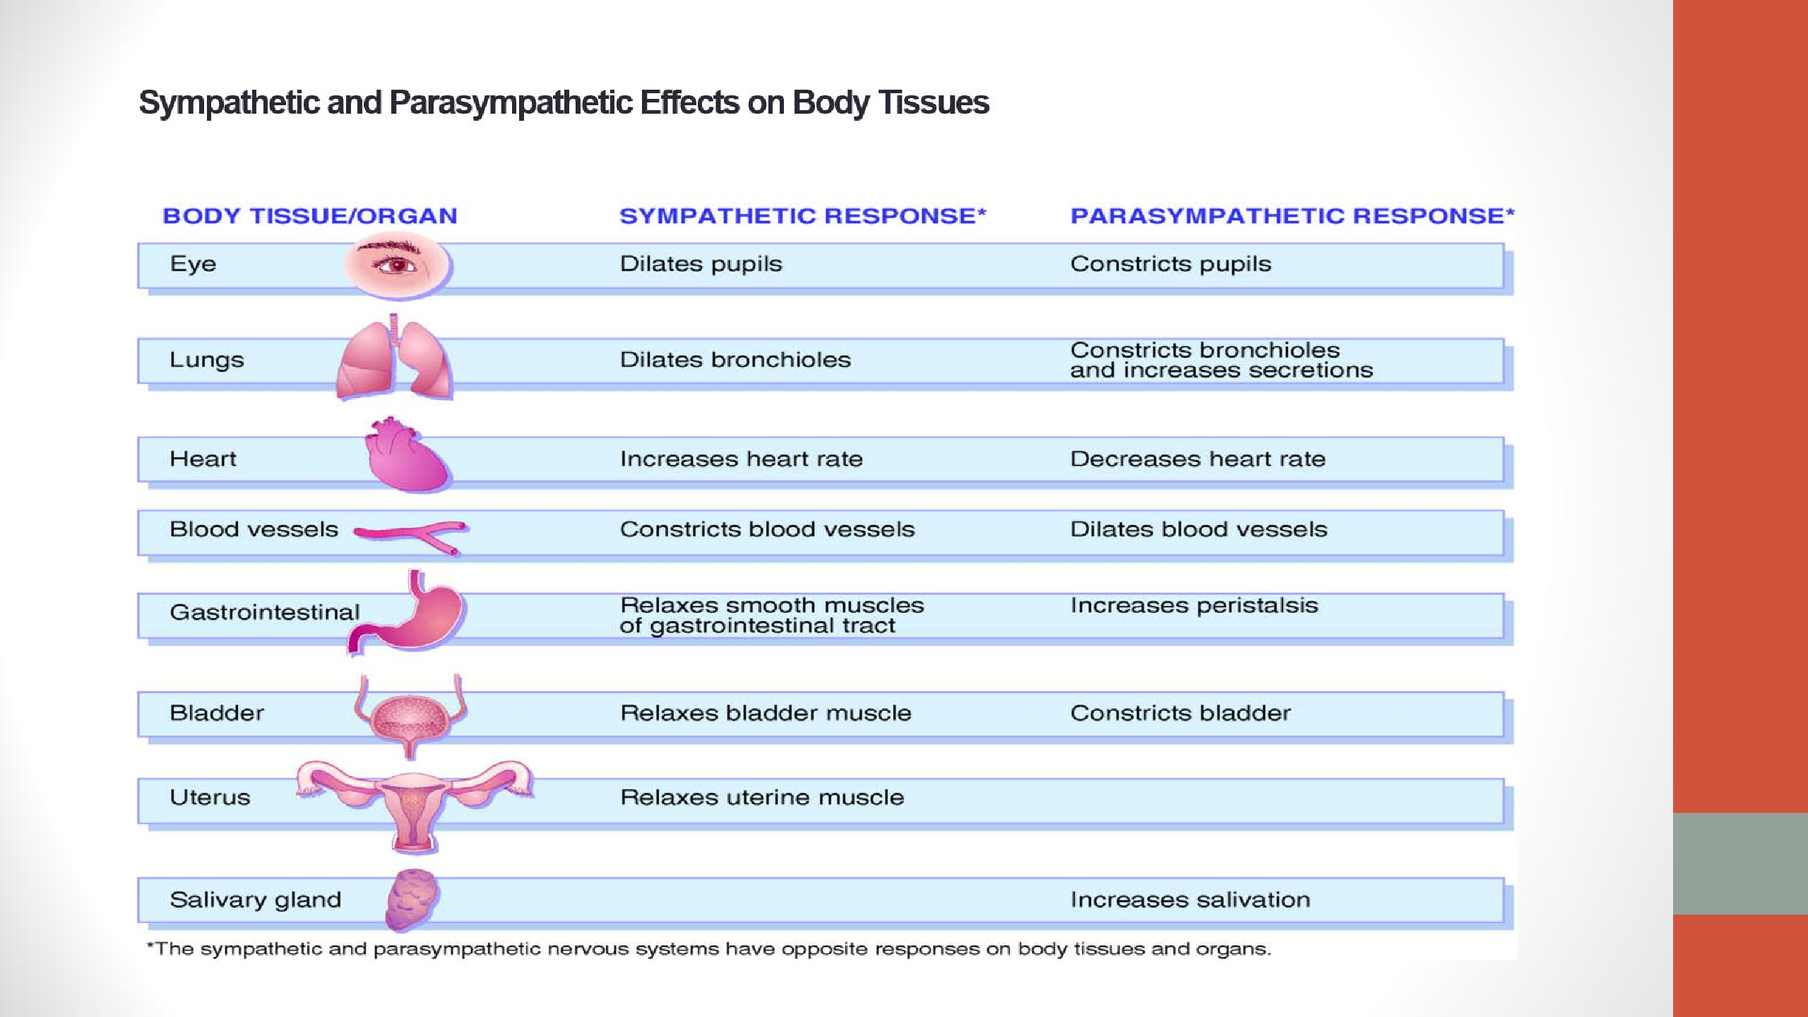

Slide 6
ADRENERGIC NEUROTRANSMITTERS

Slide 7
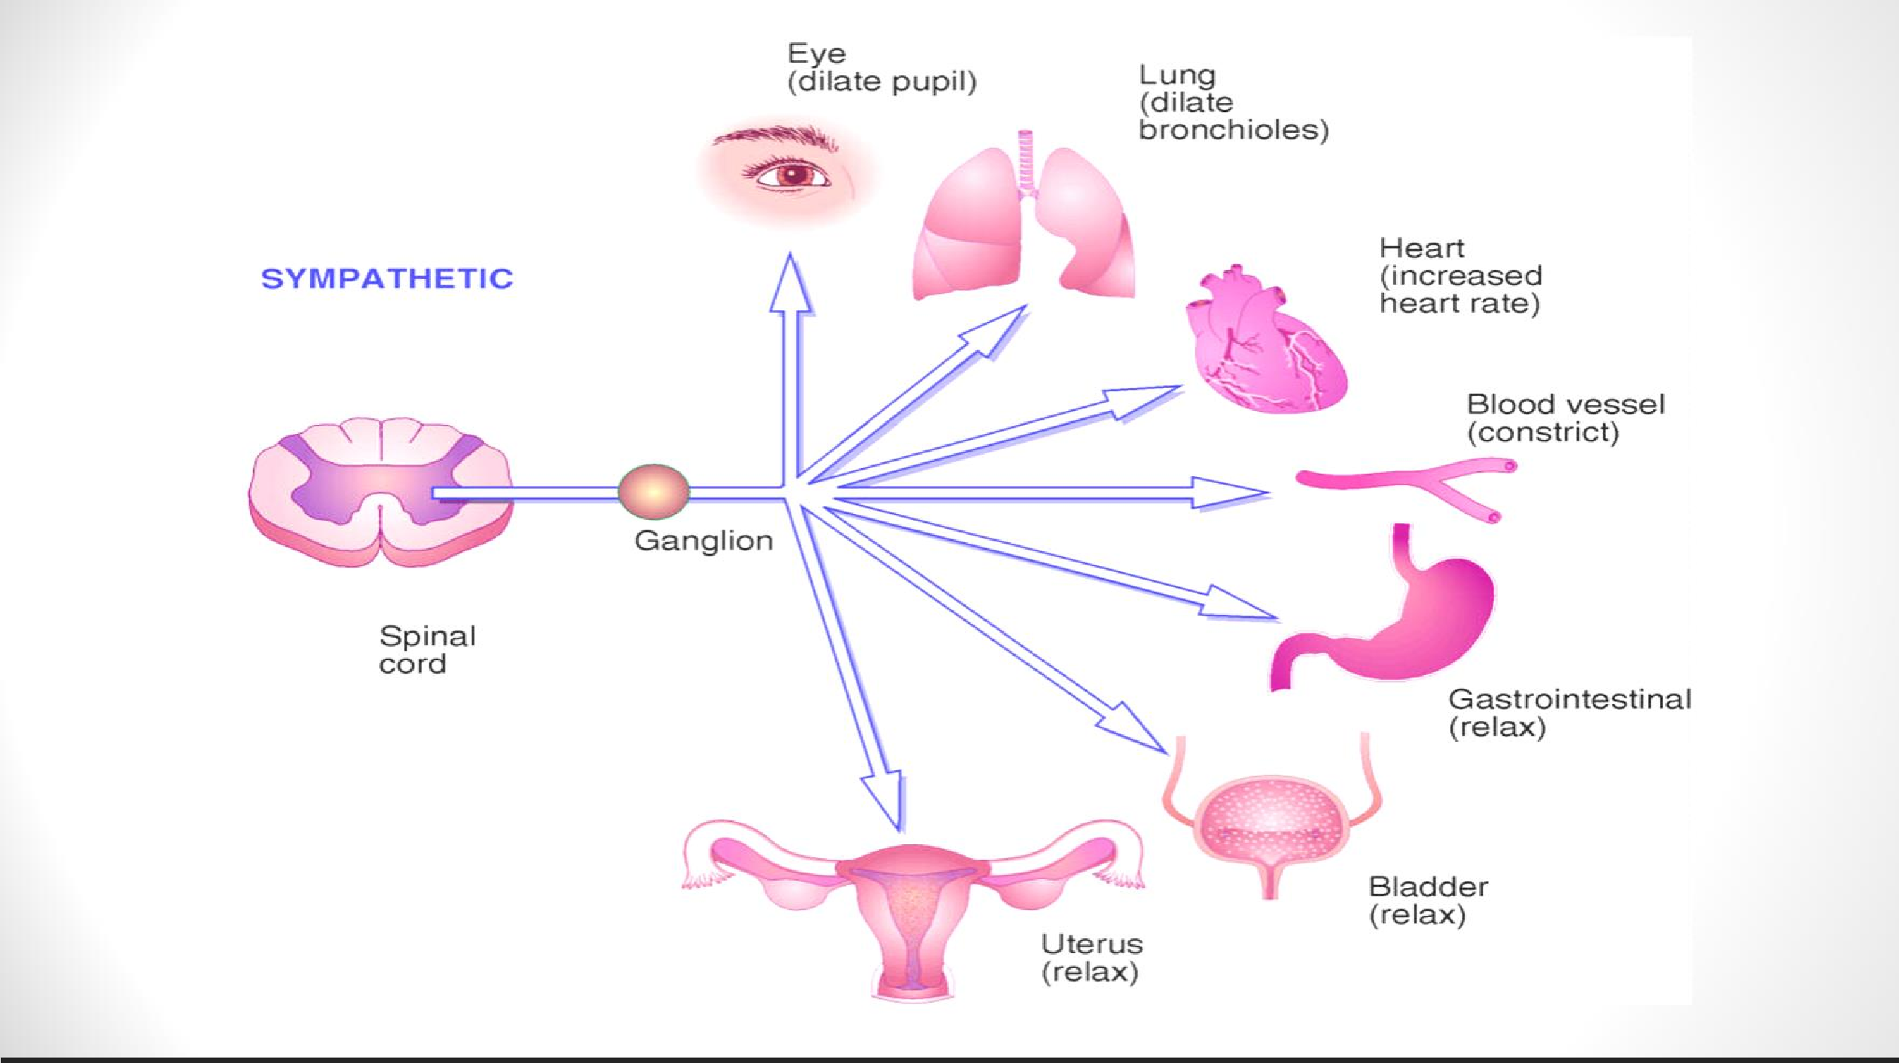

Slide 8
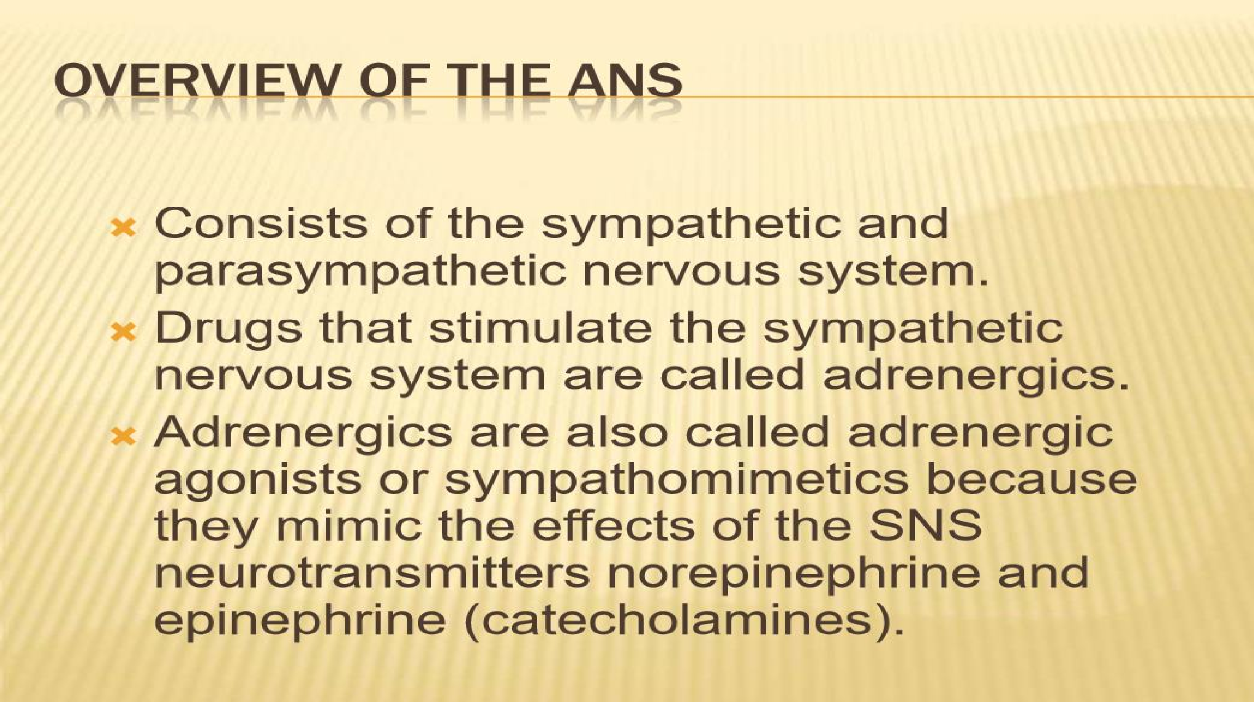

Slide 9
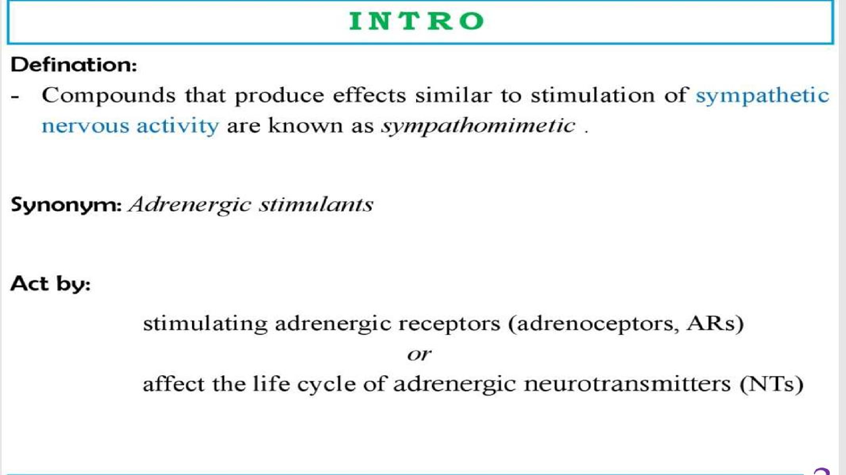

Slide 10
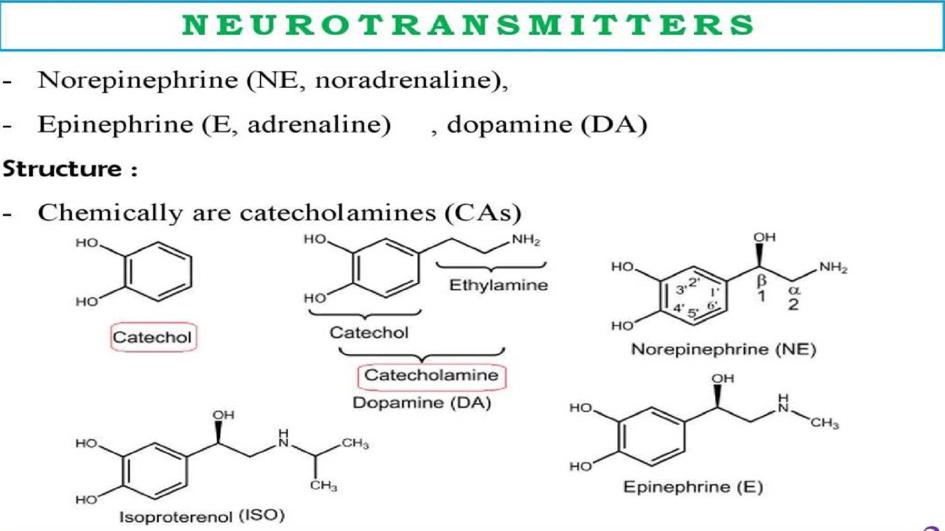

Slide 11
BIOSYNTHESIS &CATABOLISM OF CATECHOLAMINES
Synthesis
The endogenous catecholamines- dopamine, noradrenaline and adrenaline are all synthesized from tyrosine.
The tyrosine enters the adrenergic nerve via aromatic L amino acid transporter. (Na+-tyrosine symporter).
Tyrosine hydroxylase oxidizes tyrosine to dihydroxyphenylalanine (L-DOPA).
Aromatic L-amino acid decarboxylase converts LDOPA into dopamine.
Dopamine enters the synaptic vesicles via vesicular monoamine transporter (VMAT) in exchange with H+ ions. Within synaptic vesicles dopamine gets converted to noradrenaline by the enzyme dopamine-β- hydroxylase. Dopamine is the neurotransmitter in the dopaminergic neurons.
Noradrenaline is the main NT in the adrenergic neurons. But in the adrenal medulla noradrenaline is converted into adrenaline by the enzyme phenylethanolamine N-methyl transferase (PNMT). Hence adrenaline is the main NT in the adrenal medulla.

Slide 12
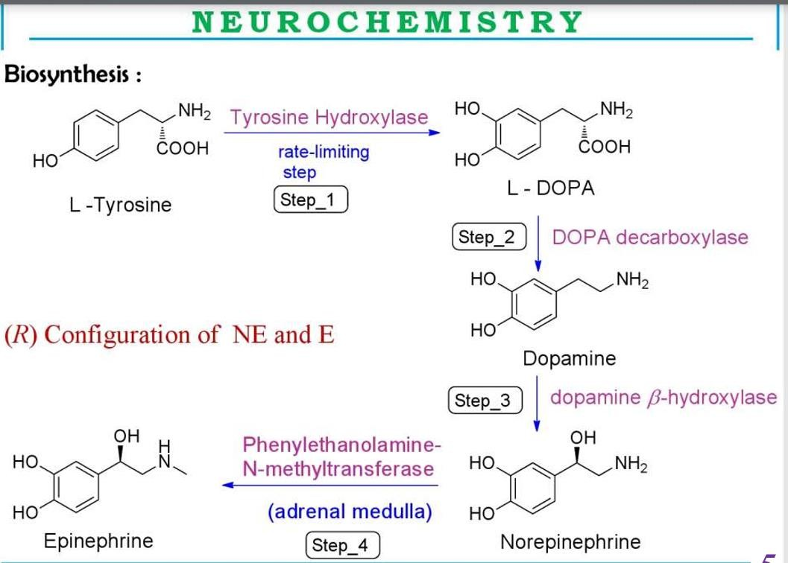

Slide 13
Release
On arrival of an impulse at the adrenergic nerve ending, the voltage gated calcium channels get opened.
This leads to influx of calcium ions.
The triggered calcium causes rupture of synaptic vesicles by a process called exocytosis.
This releases the noradrenaline into the synaptic cleft (NEJ-neuro effector junction). The noradrenaline binds to the alpha receptors or beta receptors present on the presynaptic or post synaptic membrane.
This initiates the pharmacological response.

Slide 14
METABOLISM
Noradrenaline is metabolized by two main enzymes- Catechol-o-methyl transferase (COMT) and monoamine oxidase (MAO).
COMT is present in the circulating blood and this enzyme degrades the circulating catecholamines.
Whereas MAO is located in the adrenergic neurons and this degrade the noradrenaline located in the adrenergic nerves (outside the vesicles).
COMT, MAO and aldehyde dehydragenase degrade the catecholamines into multiple intermediates and finally into vanillyl mandelic acid (VMA), which is excreted through urine.
•

Slide 15
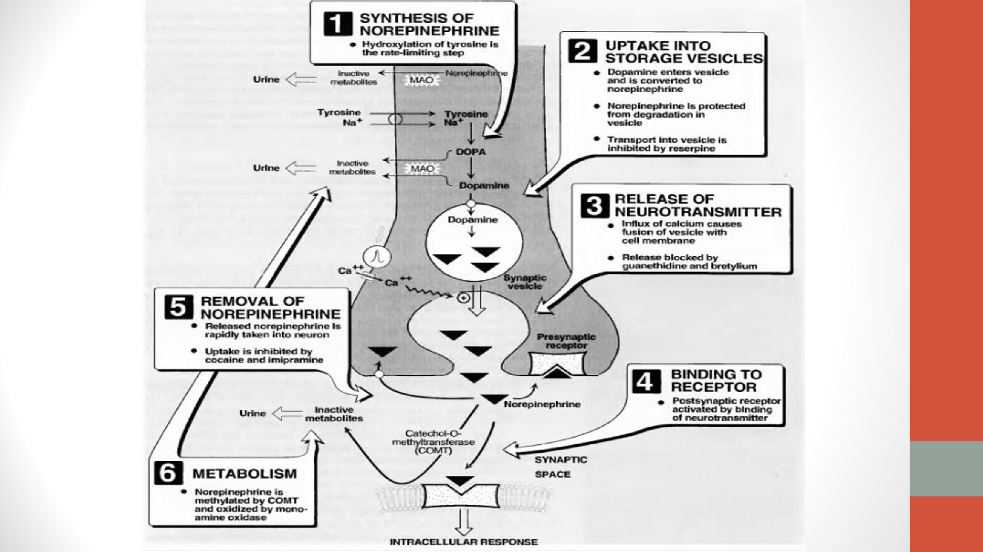

Slide 16
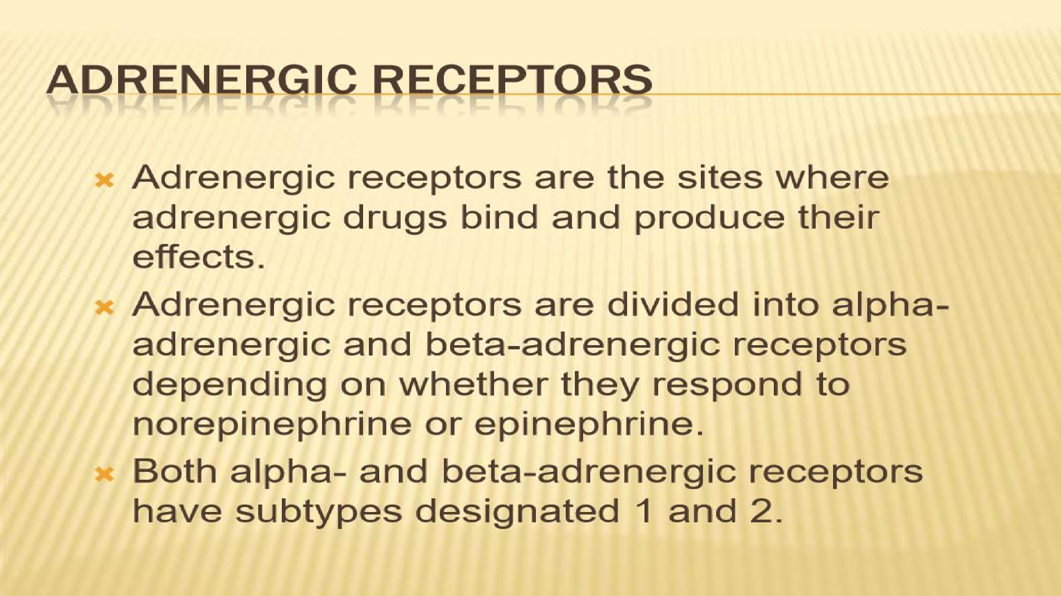

Slide 17
Adrenergic receptors- (adrenoceptors) are selective for nor adrenaline and adrenaline. There are two types- α-adrenoceptors and β-adrenoceptors.
1). α-adrenoceptors- They are divided into α1 and α2 subclasses.
α1 adrenoceptor is a G protein coupled receptor (GPCR) associated with Gq type of G protein.
When adrenaline binds to this receptor, GDP converted to GTP.
The -GTP complex binds to the membrane bound phospho lipase-C (PLC).
The activated PLC converts membrane phospholipids phosphatidylinositol-4,5bisphosphate (PIP2) into inositol-1,4,5- triphosphate (IP3) and diacylglycerol (DAG).
The DAG remains in the membrane and activates protein kinase C (PKC).
The activated PKC phosphorylates several cellular proteins.
IP3 stimulates the release of calcium from ER into the cytosol.
The released calcium ions are responsible for the action.
The calcium ions bound to the calmodulin protein (CaM). Ca2+- CaM complex activates the MLCK (Myosin light chain kinase).
The activated MLCK causes the phosphorylation of myosin-LC.
The myosin-LC-P causes smooth muscle contraction

Slide 18
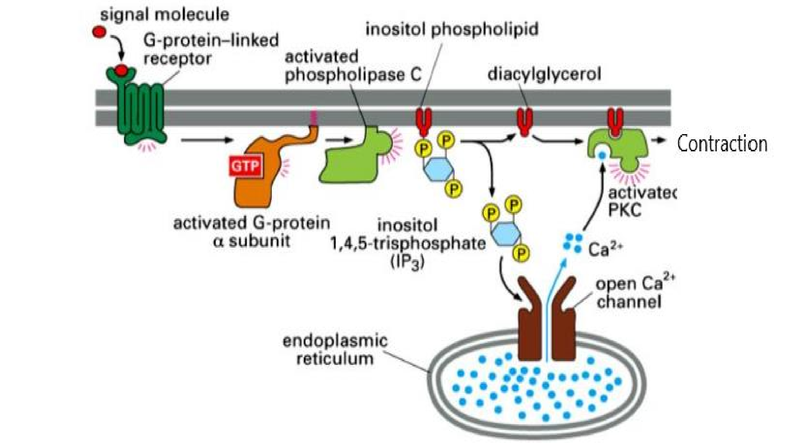

Slide 19
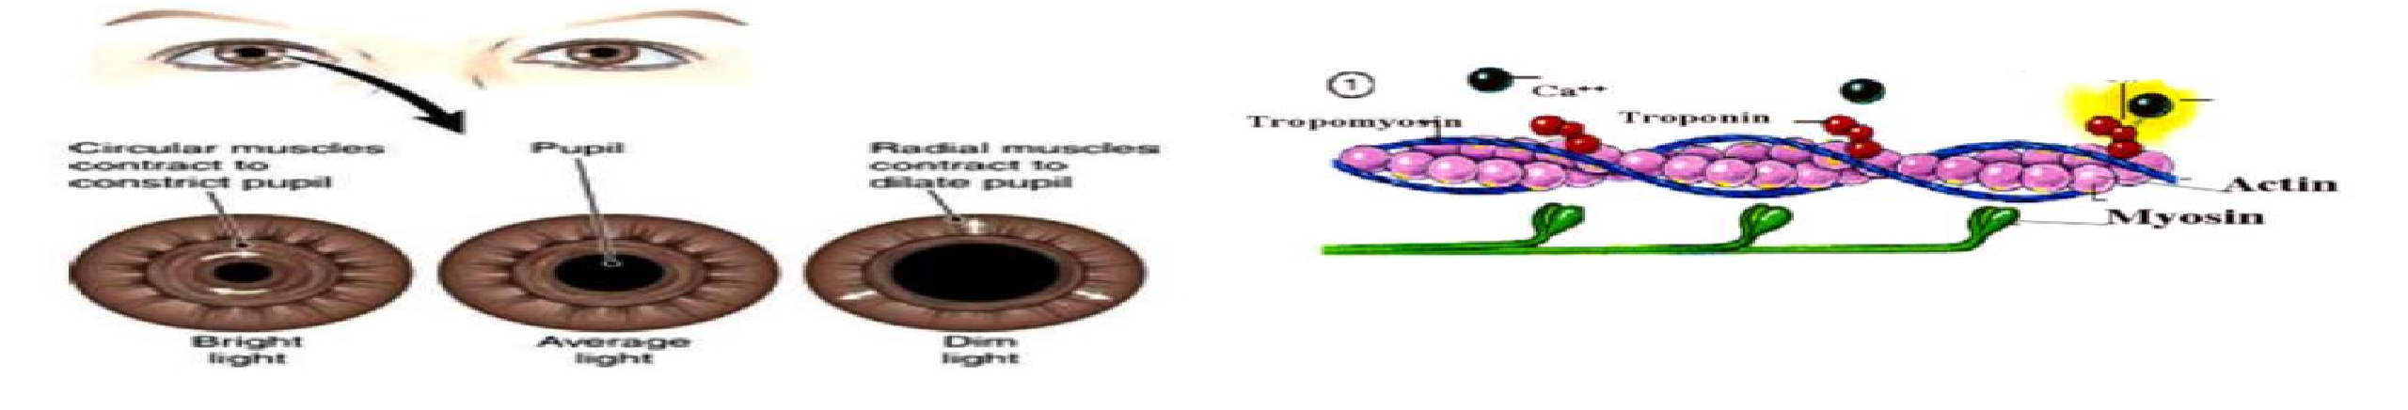
Important locations of α1 adrenoceptors- Vascular smooth muscles, genitourinary smooth muscle, radial muscle, intestinal smooth muscle, heart and liver (Except intestine all actions are excitatory).
Vascular smooth muscles- Vasoconstriction (MOA as above).
Genitourinary smooth muscles- Contractions (MOA as above).
Radial muscle- Contraction –mydriasis (MOA as above).
Heart- Increases the rate and force of heart contraction. MOA- The calcium ions bind to the troponin, this leads to the interaction of actin-myosin causing heart muscle contraction.
Liver- Increases glycogenolysis and gluconeogenesis. MOA- DAG causes activation of PKC. The activated PKC causes the
phosphorylation of enzymes needed for glycogenolysis and gluconeogenesis.
Intestinal muscles- Relaxation. The activated protein kinase causes phosphorylation of cellular proteins. For eg K+ channel activation leads to efflux of K+ ions leading hyperpolarization (IPSP). The IPSP is also due to inactivation of calcium channels.

Slide 20
α2 adrenoceptor- is a G protein coupled receptor (GPCR) associated with Gi type of G protein.
When adrenaline binds to this receptor, GDP converted to GTP, αβγ subunits of G protein gets detached.
The α-GTP complex binds to the membrane bound adenylyl cyclase (AC).
The inhibited AC decreases the formation of cAMP. The α-GTP complex also activates the K+ channel.
This increases the removal of K+ ions from the cell to outside.
This decreases the potential inside the cell (hyperpolarization).
The α-GTP complex also inactivates the Ca2+ channels.
This decreases the influx of Ca2+ ions into the cell.
This also decreases the potential within the cell causing hyperpolarization. Hence the action is inhibition.

Slide 21
Important locations of α2 adrenoceptors-
Pancreatic β cells, platelets, nerve, vascular smooth muscles. (all actions are inhibitory except vascular smooth muscle).
a) Pancreatic β cells- Decreases insulin secretion. b)Platelets- Aggregation.
Nerve- Function as auto-receptors, neuronal inhibition.
Vascular smooth muscle- Vasoconstriction (both α1 and α2 causes vasoconstriction)

Slide 22
β-adrenoceptors
These are divided into three types- β1, β2 and β3.
All three belongs to stimulatory (Gs) type of G protein coupled receptors. β-adrenoceptor is a G protein coupled receptor (GPCR) associated with Gs type of G protein. When adrenaline binds to this receptor, GDP converted to GTP, αβγ subunits of G protein gets detached. The α-GTP complex binds to the membrane bound adenylyl cyclase (AC). The stimulated AC increases the formation of cAMP. Increased cAMP activates protein kinases (especially protein kinase A), which phosphorylates cellular proteins, including ion channels.
β1 receptors located on heart (SAN and myocardium), renal juxta glomerular cells. Increases the heart rate (chronotropy) and force of heart contraction (inotropy) and increases the rennin secretion.
β2 receptors are located in smooth muscles, liver, and skeletal muscles. Stimulation of β2 receptors in bronchial smooth muscles causes bronchodilatation. This effect is due to Gs independent activation of K+ channels resulting in hyperpolarization. This relaxes the bronchial smooth muscles. In liver stimulation of β2 receptors results in increased blood sugar level. In skeletal
muscle β2 receptors results in increased glycogenolysis.
β3 receptors are located in adipose tissue. In adipose tissue stimulation of β3 receptors results in increased lipolysis.

Slide 23
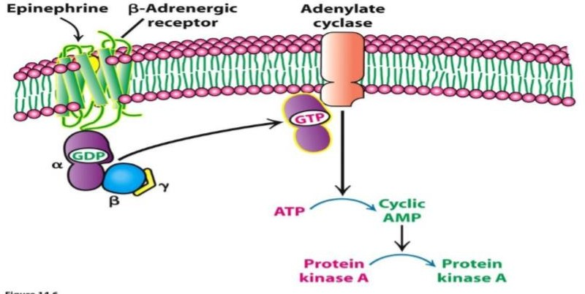

Slide 24
THANK YOU

